Slide 1


About the Test Data Factory Project
Strategic Advice
SACS Breakout
11 June 2019
If you don’t know where you are going, moving slowly might be a winning strategy.

Slide 2

Some Background as a Reminder
Testing with appropriate test data is an essential part of any process and software development.
The objective of the TDF project is to provide CDISC test datasets including documentation of deviations and warnings.
Phase 1 (completed):
Updated existing CDISC pilot datasets to comply with new standard versions
Phase 2 (work in progress):
Develop a concept and implement a TDF tool for creating test datasets based on user requirements and user input

Slide 3
Work in Progress
Scope decision: Initial focus on LB and DM domains.
Need to include study metadata outside of DM and LB
Categorized user input as metadata (study or domain) or domain content
How to collect user input:
Metadata: TDF Tool user interface
Domain content:
Excel file with one worksheet for each domain and one row on this worksheet for each domain variable.
Input specification is based on a generic “Variable Content Model”
How to generate the datasets:
One domain after another or by ‘simulating’ a clinical trial

Slide 4
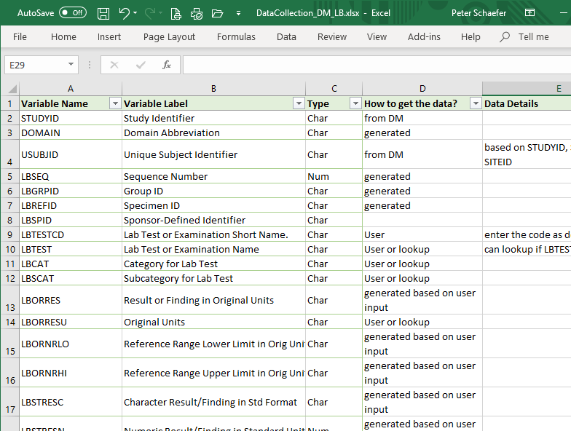
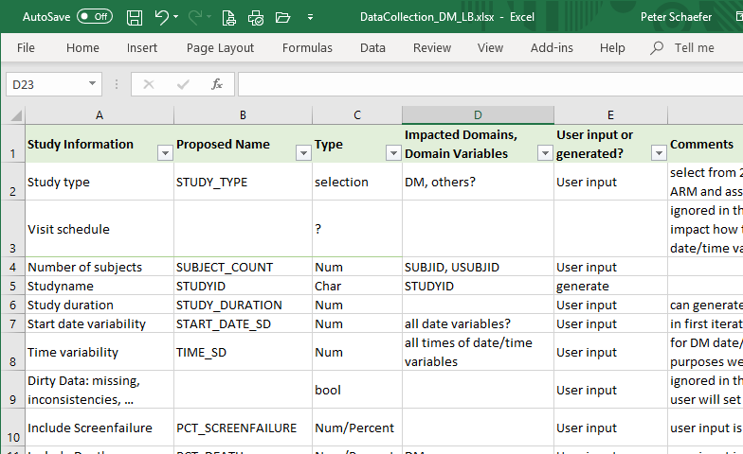
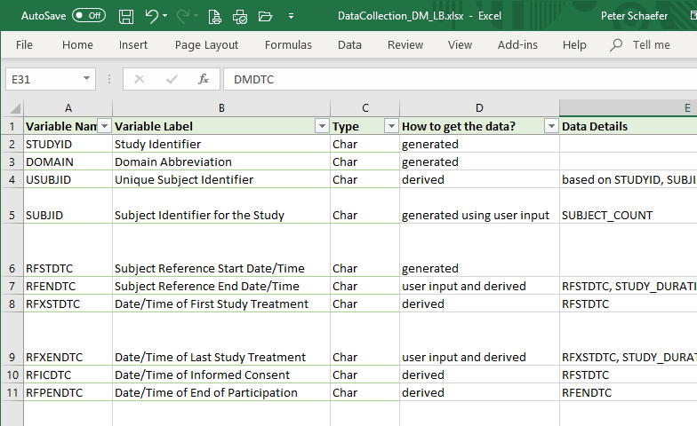
Step 1: Understand Input Requirements
LB Domain
Metadata (study, domains)
DM Domain

Slide 5
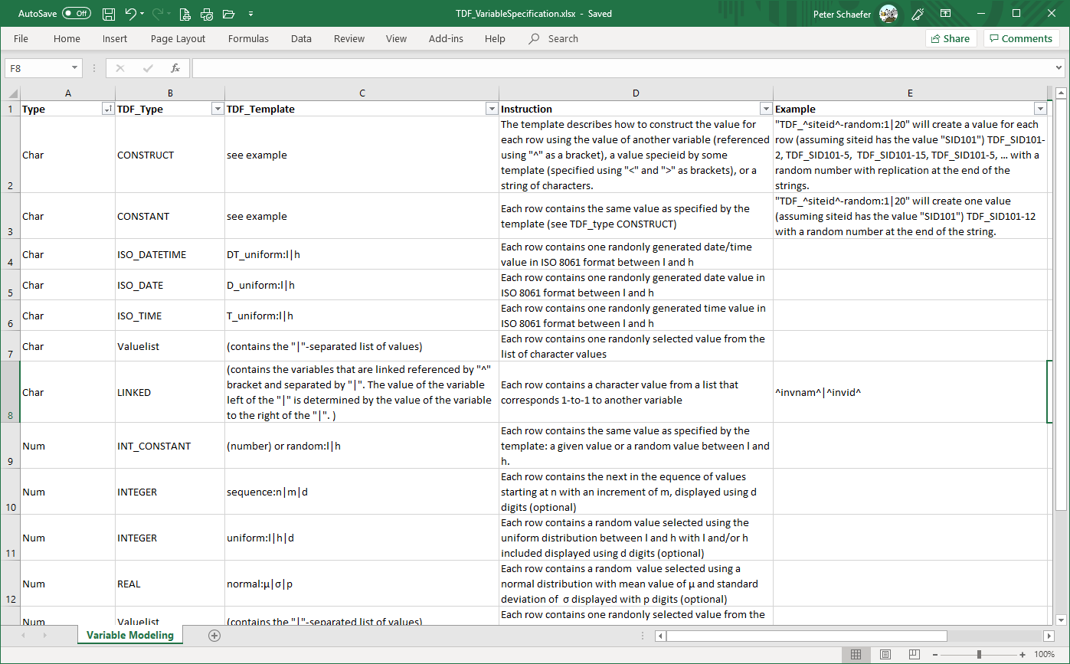
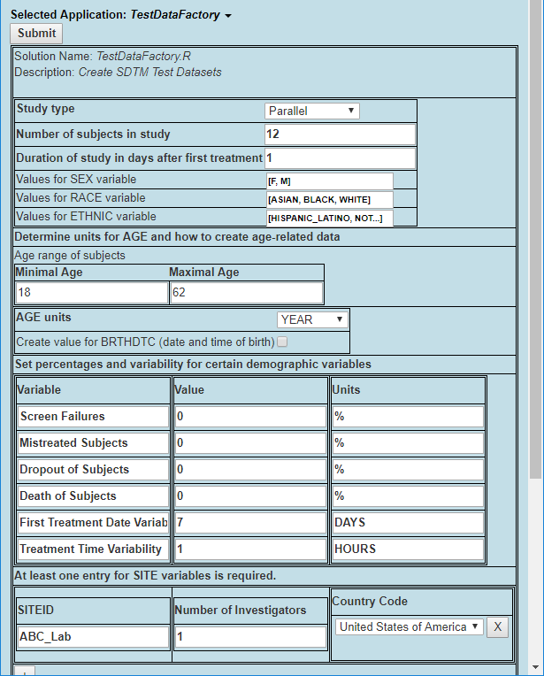
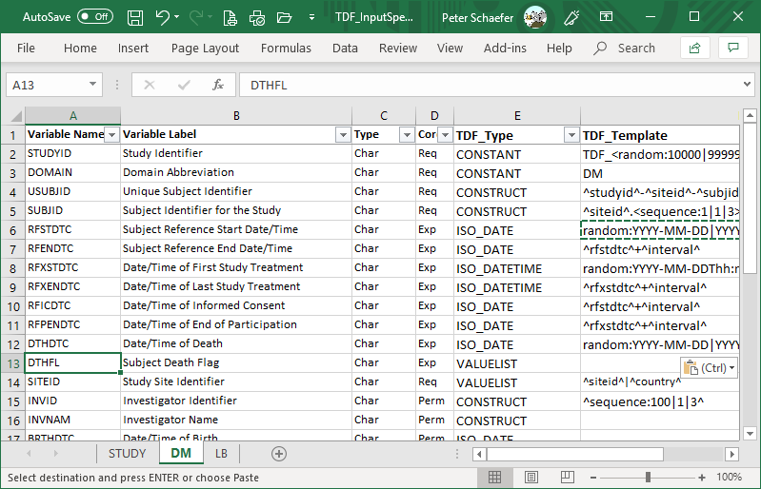
Step 2: Formalize Input Specification
Variable Content Model
Excel Worksheets (for content data)
and
User Interface (for metadata)

Slide 6
Step 3: Define TDF Tool Requirements
Alternatives for a TDF Tool:
Scripts, that each user can modify and execute as required
A “product” ready to be used.
Many additional open questions …
Desktop or SaaS product
Open source?
Access to CDISC metadata?
SAS, R, Python, or what?
Ownership and maintenance?
How to process the user input (i.e., TDF Tool workflow)?

Slide 7

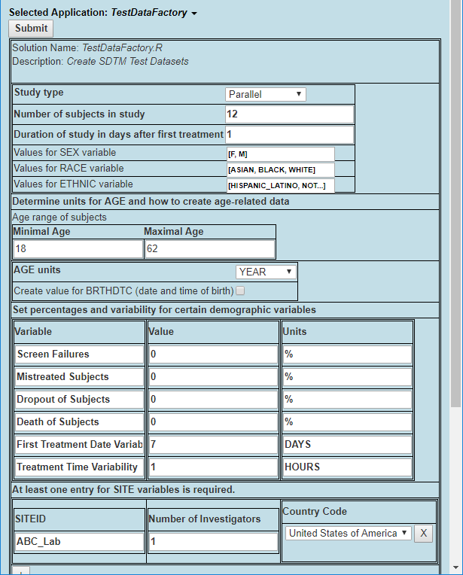
TDF Tool Workflow: Create one Domain at a Time …
Collect User Input
Create DM Domain
Create LB Domain
Create EX Domain
Create ??? Domain
Test Data Spec. (Excel)
TDF Domain Datasets
EX Domain (xpt, csv, Excel)
DM Domain (xpt, csv, Excel)
LB Domain (xpt, csv, Excel)
??? Domain (xpt, csv, Excel)

Slide 8
TDF Tool Workflow: Simulate the Study / Trial
Collect User Input
Study Setup
Visit 1: …
Visit 2: …
Visit 3: …
For each subject:
Test Data Spec. (Excel)
Create DM Records
Create LB Records
Create EX Records
Create ??? Records
TDF Domain Datasets
DM Domain (xpt, csv, Excel)
LB Domain (xpt, csv, Excel)
EX Domain (xpt, csv, Excel)
??? Domain (xpt, csv, Excel)

Slide 9
The TDF Team is working towards a TDF Tool, but …
Currently, the ultimate deliverable would be a TDF Tool that creates test datasets based on user input.
But is that what you want? Use Post-its to write down your expectations and requirements, for example:
Concept  scripts  ready-to-use tool?
Desktop  SaaS?
Paid and maintained  Open Source?
SEND  SDTM  ADaM
Most versus least important domains: ____________ versus ____________
The top-3 features: ____________ , ____________ , ____________
If you are not really interested in the TDF project, write that down as well.
Don’t feel limited by these questions!!!

Slide 10
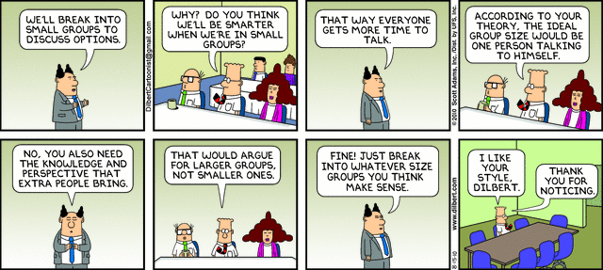

Slide 11
Strategic Advice
If you don’t know where you are going, moving slowly might be a winning strategy.

